Slide 1



Leveraging Molecular Databases for Variant Interpretation
Functional Genomics; understanding how pathological missense variants affect proteins
Instructor:
Pouria Dasmeh
Center for Human Genetics, Marburg University/UKGM medical center,
dasmeh@staff.uni-marburg.de
www.dasmehlab.com
Course material
(lectures & tutorials)
https://github.com/dasmeh/UKGM_Humangenetik_PROTEINS

Slide 2
Course agenda and organizational notes
Theory lecture (04:30-05:00): Protein sequence, structure, function
Practical session 1 (05:00-05:30)
Short break
Practical session 2 (05:45:06:30)

Slide 3
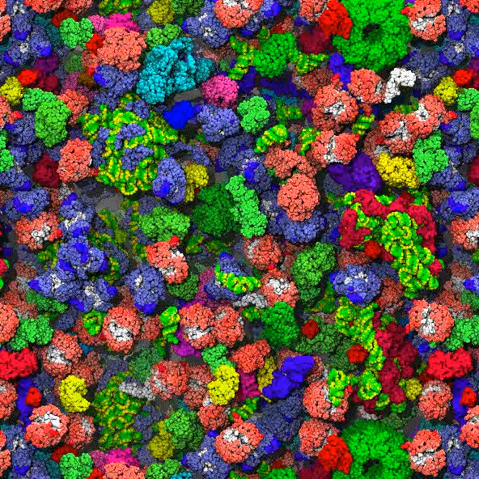
PLoS computational biology,
6(3), e1000694.
Cytoplsm’s viscosity > 100 mPa.s
Water ~ 1 mPa.s
Engine oil ~ 100 mPa.s

Slide 4
Part 1: Protein Sequence, Structure, Function

Slide 5
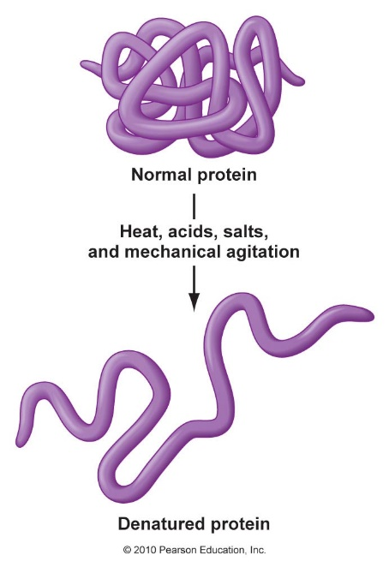
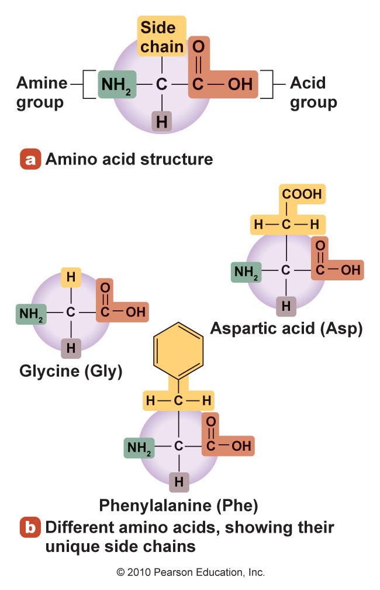
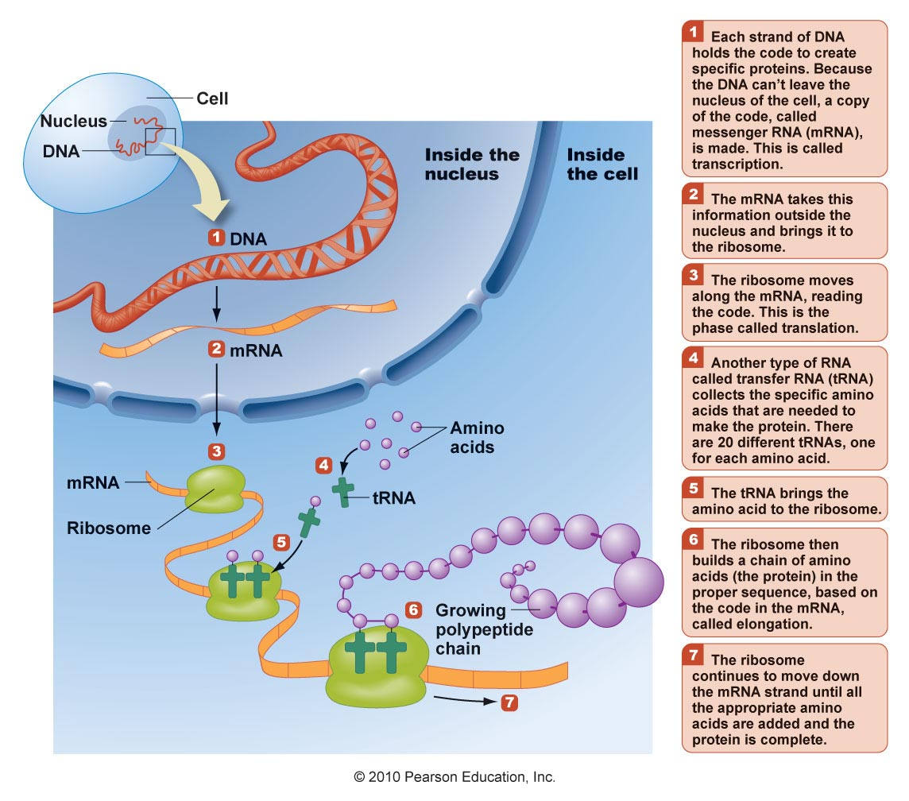
Proteins and Amino Acids

Slide 6
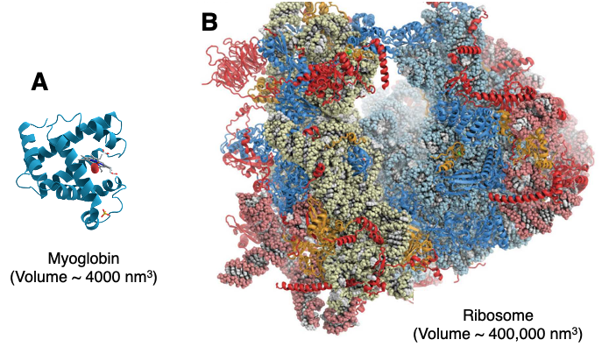
Proteins
Made up of chains of amino acids
Are involved in most of the body’s functions and life processes
The sequence of amino acids is determined by DNA

Slide 7
Structure of Proteins
Made up of chains of amino acids; classified by number of amino acids in a chain
Peptides: fewer than 50 amino acids
Dipeptides: 2 amino acids
Tripeptides: 3 amino acids
Polypeptides: more than 10 amino acids
Proteins: more than 50 amino acids
Typically 100 to 10,000 amino acids linked together
Chains are synthesizes based on specific bodily DNA.
Amino acids are composed of carbon, hydrogen, oxygen, and nitrogen.

Slide 8
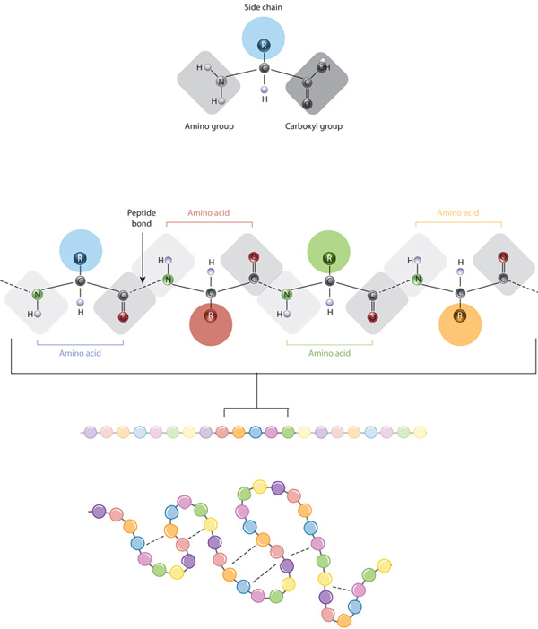
An amino acid

Slide 9
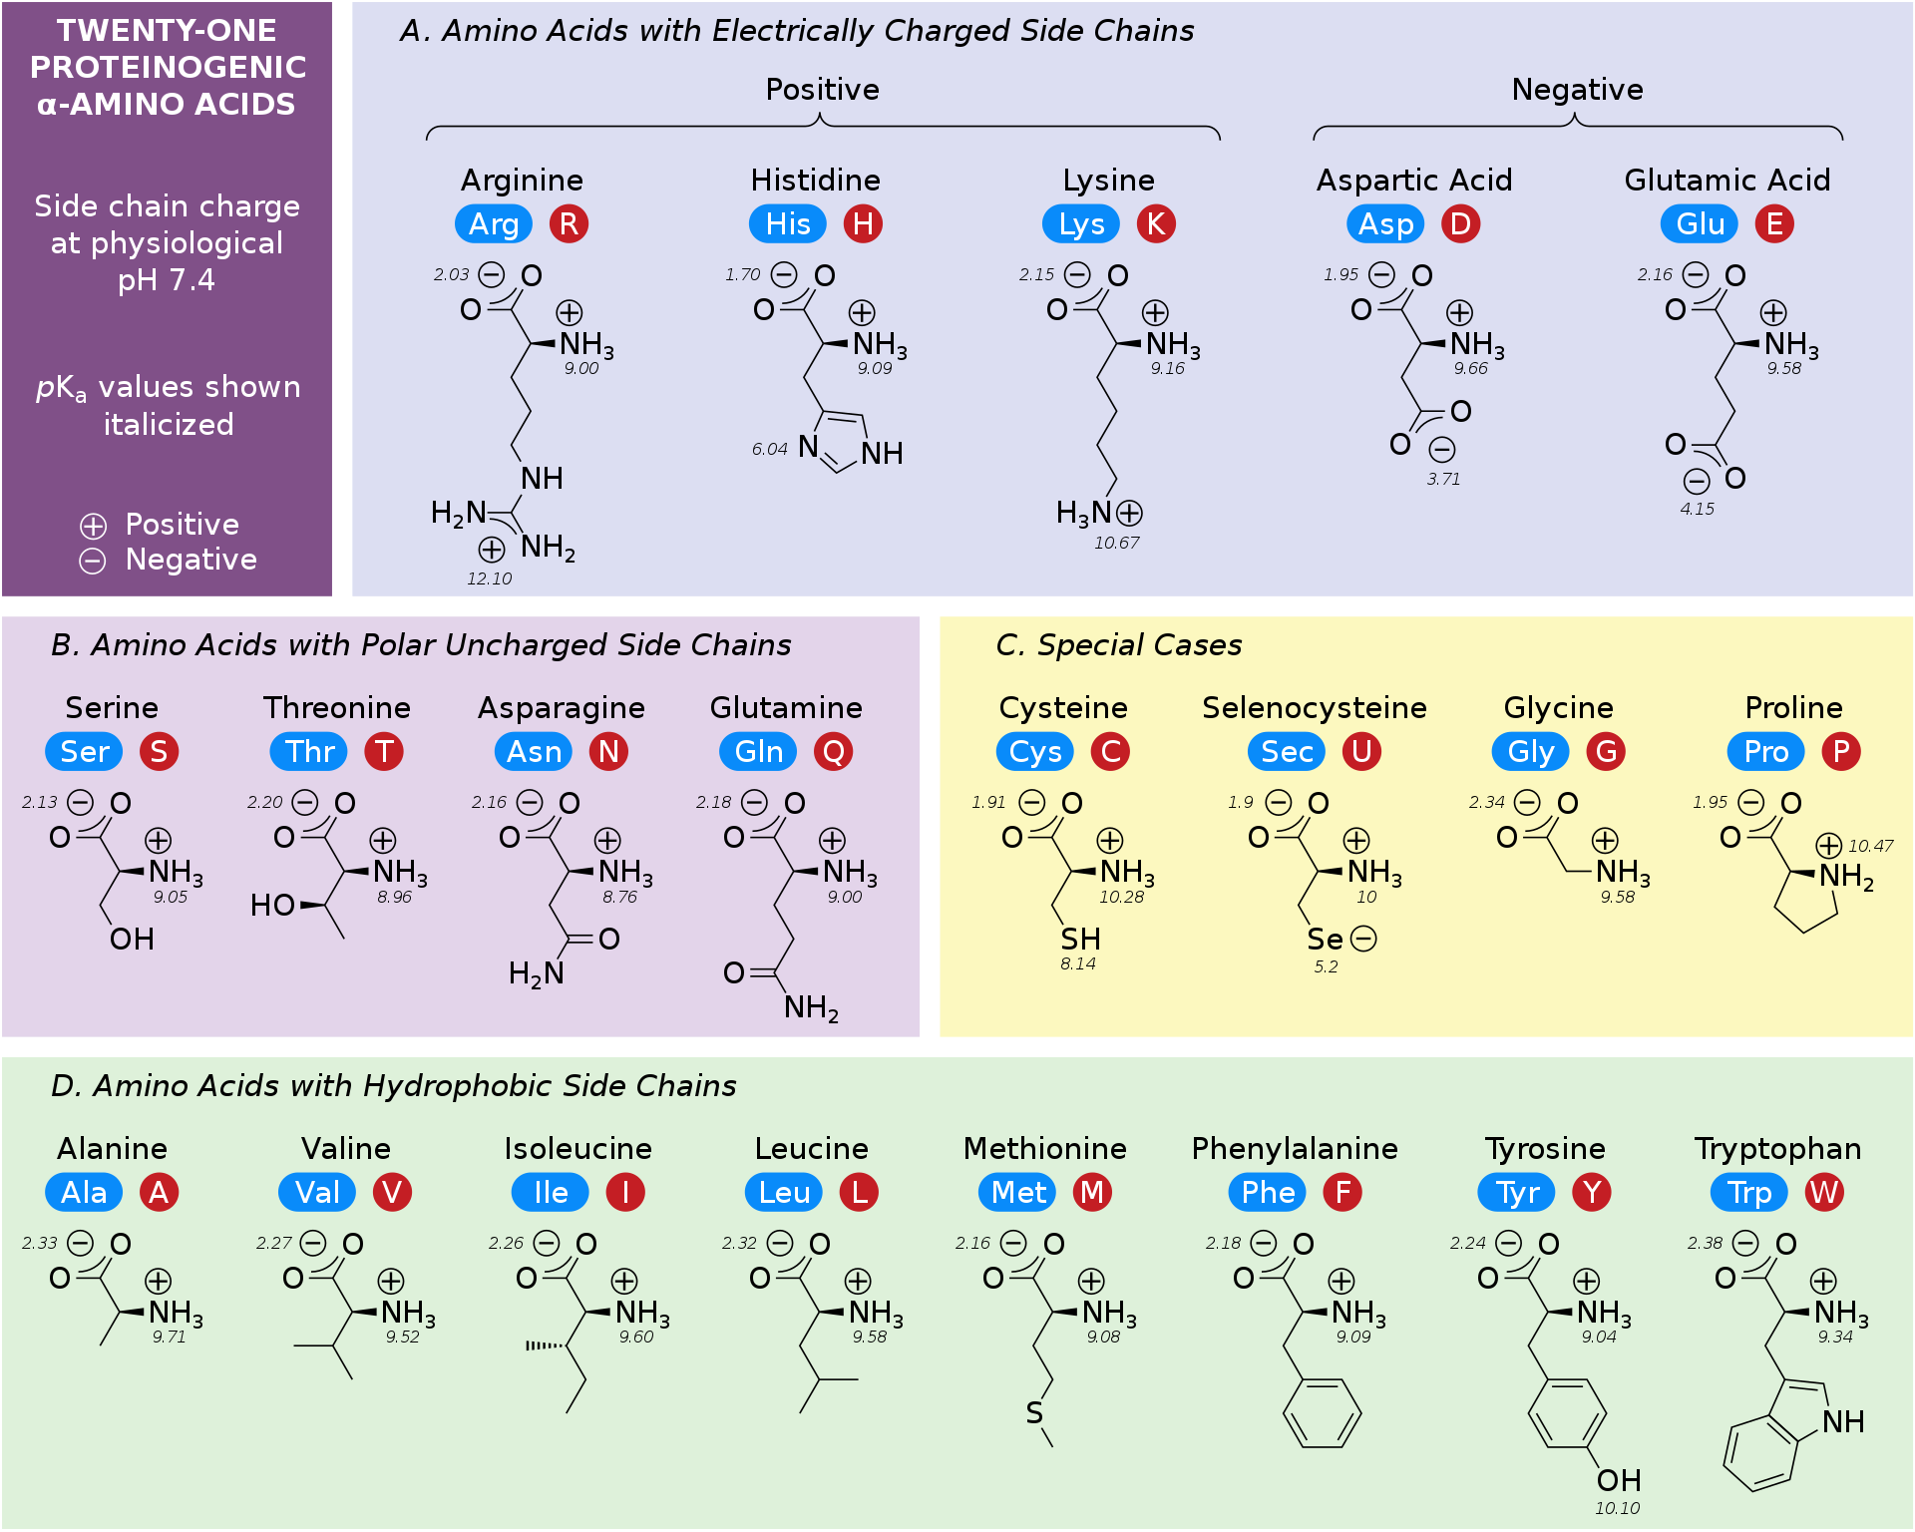
Amino acids

Slide 10
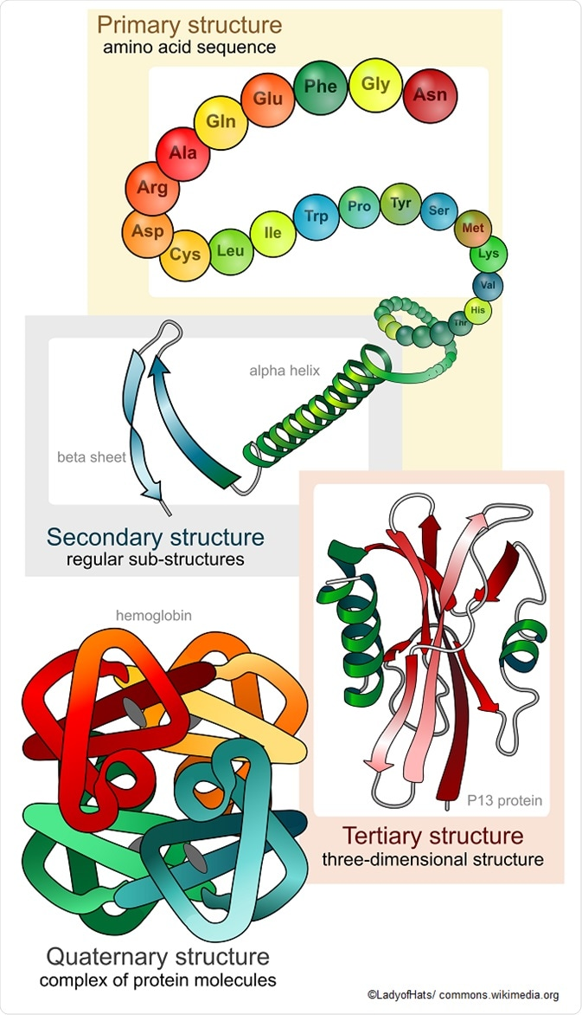
Structure of the Protein

Slide 11
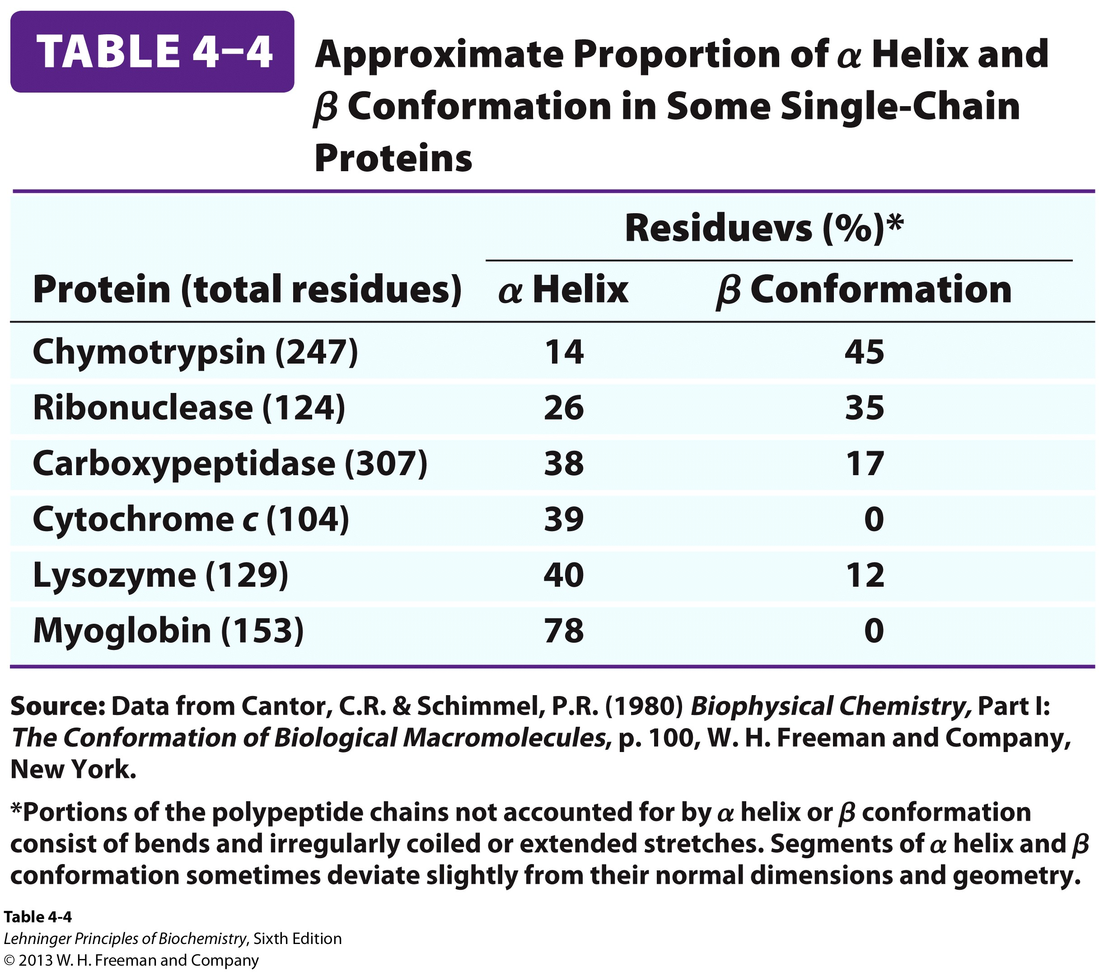
Different proteins have different percentages of secondary structure elements

Slide 12
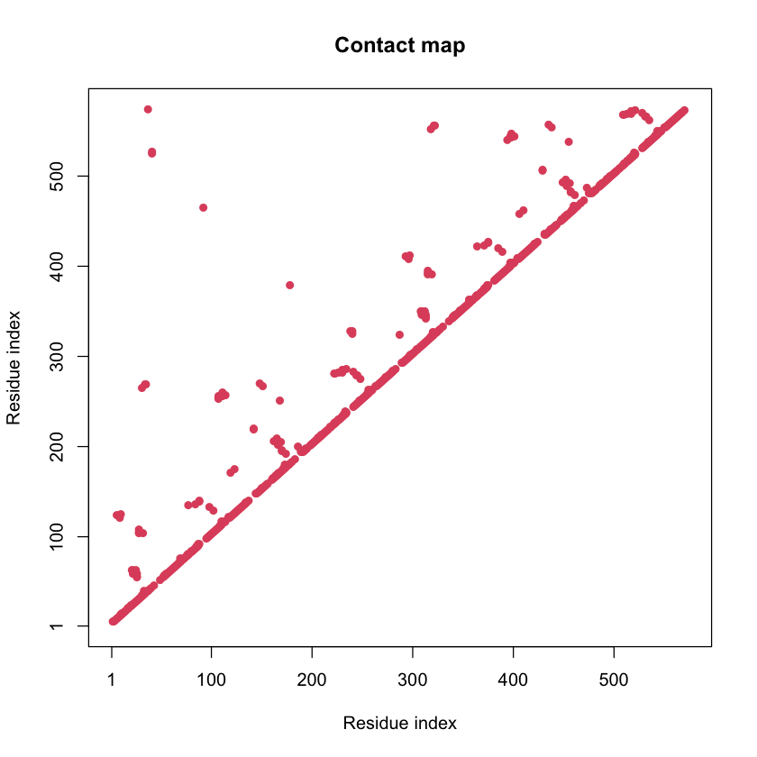
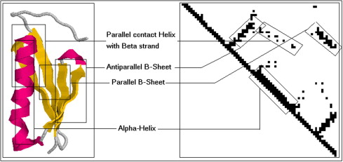
Protein Contact Map

Slide 13
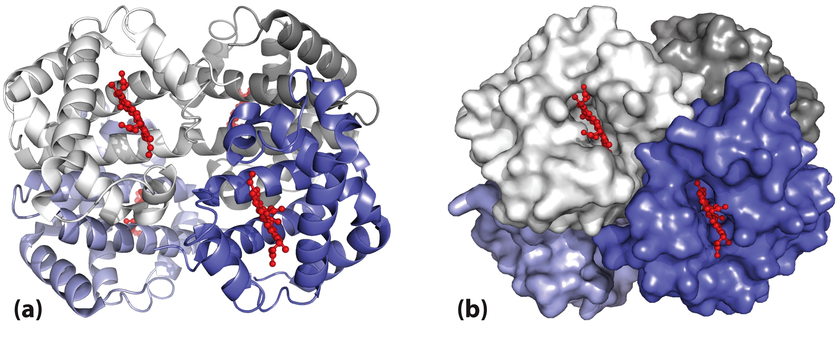
Quaternary Structure of Hemoglobin
Hemoglobin (M_{w} 64,500) contains four polypeptide chains with one heme group each.
The protein portion, globin, consists of two α chains (141 residues each) and two ß chains (146 residues each).
The subunits of hemoglobin are arranged in symmetric pairs, each pair having one α and one ß subunit. Hemoglobin can therefore be described either as a tetramer or as a dimer of αß protomers.

Slide 14

Protein denaturation
Desaturating agent/factors:
Heat
Acids
Bases
Salts
Mechanical agitation
Mutations
(interference with folding)
Figure 6.5

Slide 15
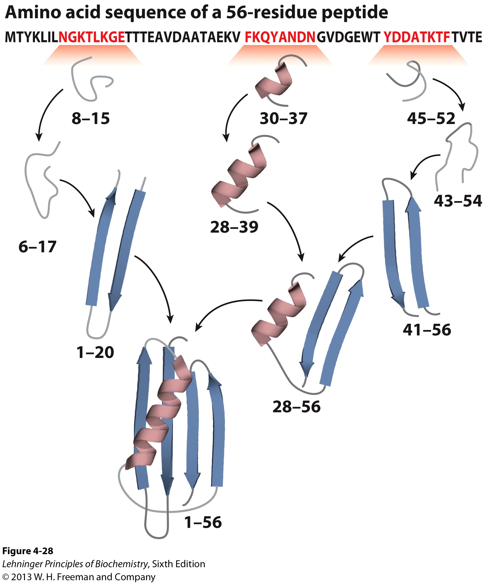
Overview of Protein Folding

Slide 16
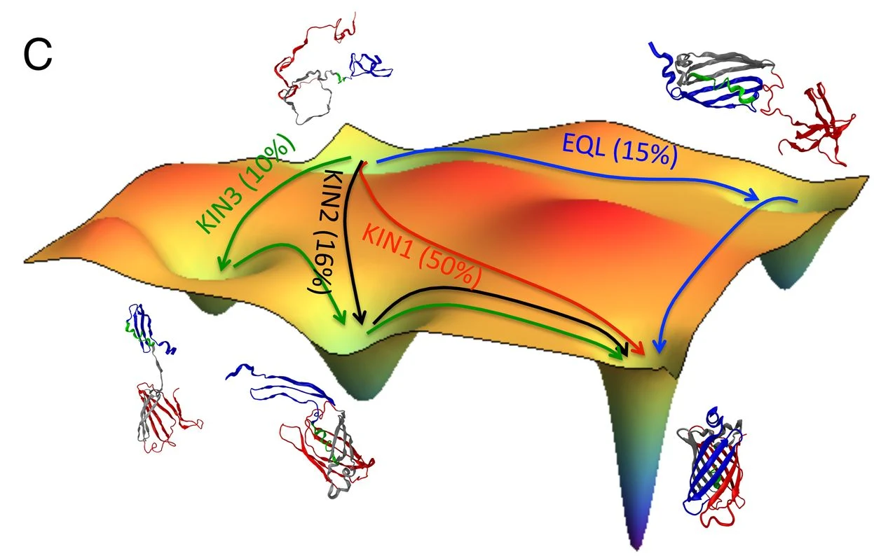
Protein Folding Intermediates
PNAS, 109.44 (2012): 17832-17838.

Slide 17
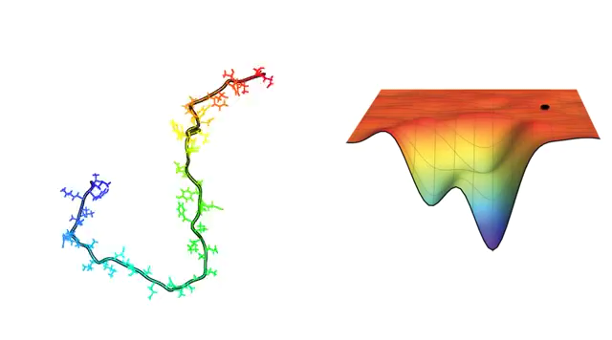
Credit: C. Fennell,
Laufer Center for Physical and Quantitative Biology,
Stony Brook University

Slide 18
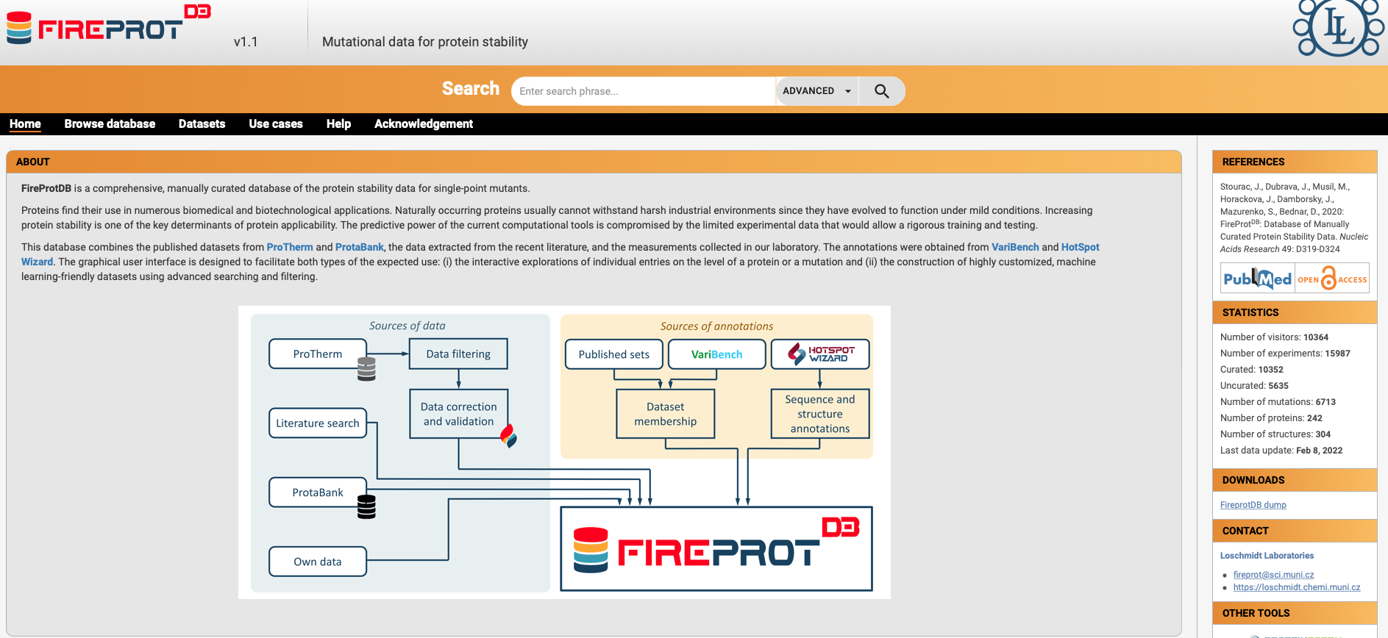
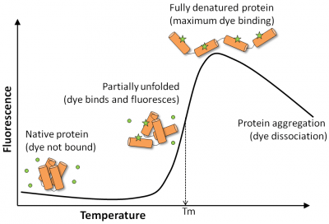
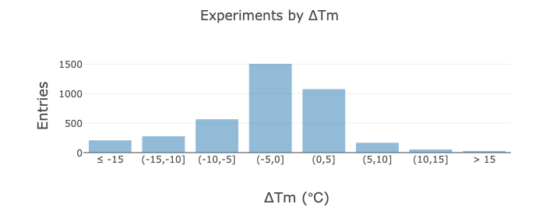
Mutational Effects on Protein Stability
(FireProt database)
What does an average mutation do to a protein ?!

Slide 19
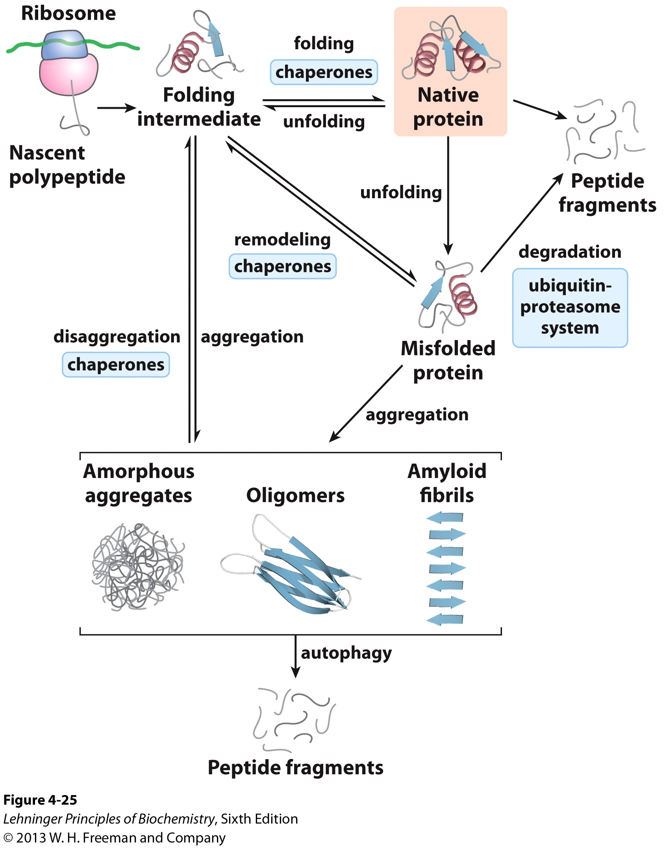
Proteostasis
The maintenance of an active set of cellular proteins.
First, proteins are synthesized on a ribosome.
Second, multiple pathways contribute to protein folding, many of which involve the activity of complexes called chaperones. Chaperones (including chaperonins) also contribute to the refolding of proteins that are partially and transiently unfolded.
Third, proteins that are irreversibly unfolded are subject to sequestration and degradation by several additional pathways

Slide 20
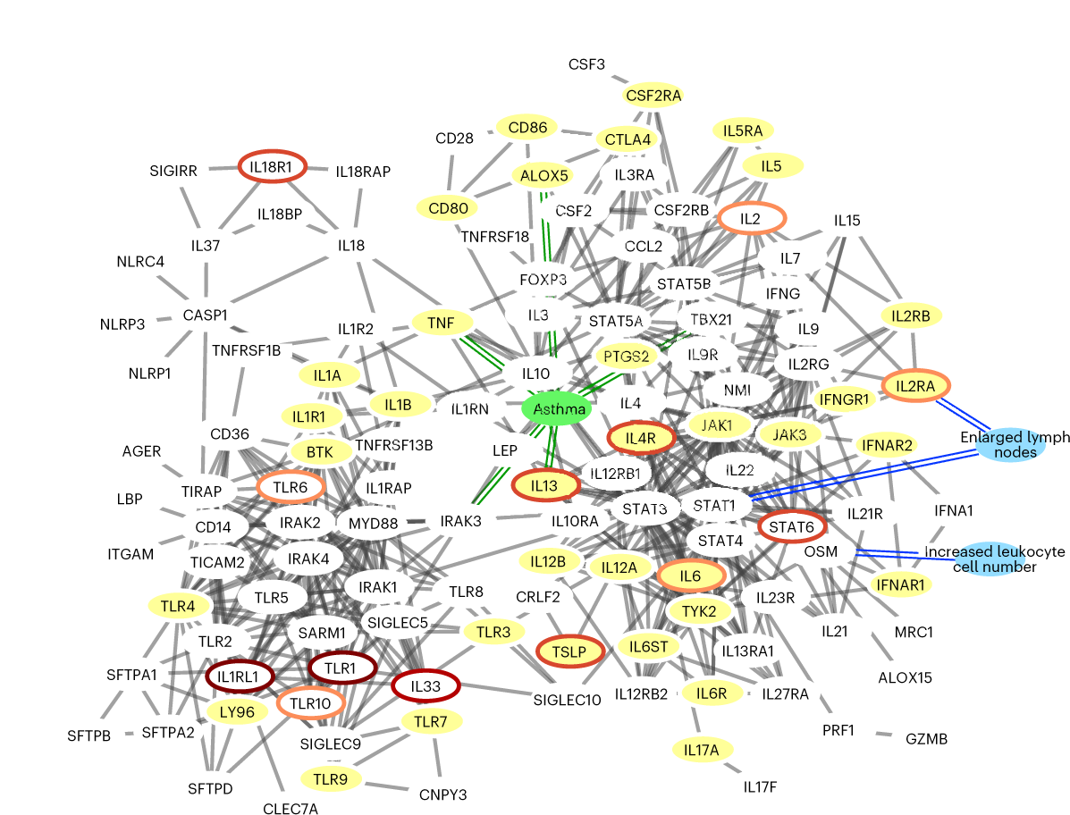
Proteins work together!
Proteins “work together” forming multi complexes to carry out the specific functions
Nature genetics, 55(3), 389-398.

Slide 21
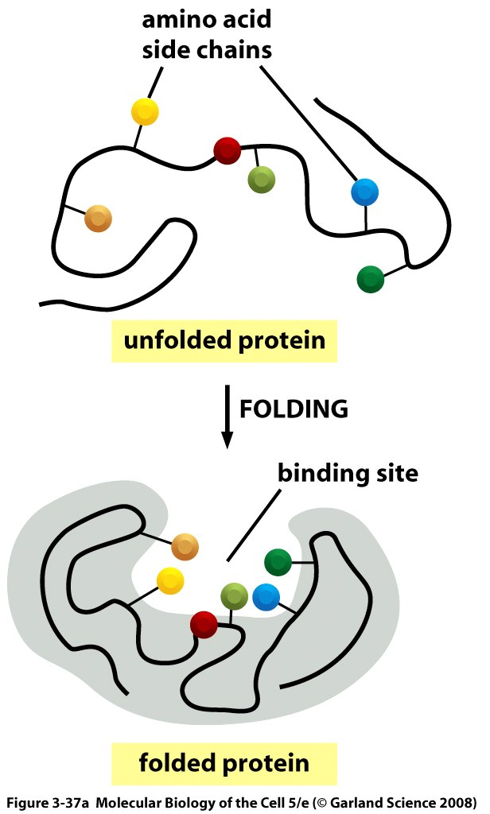
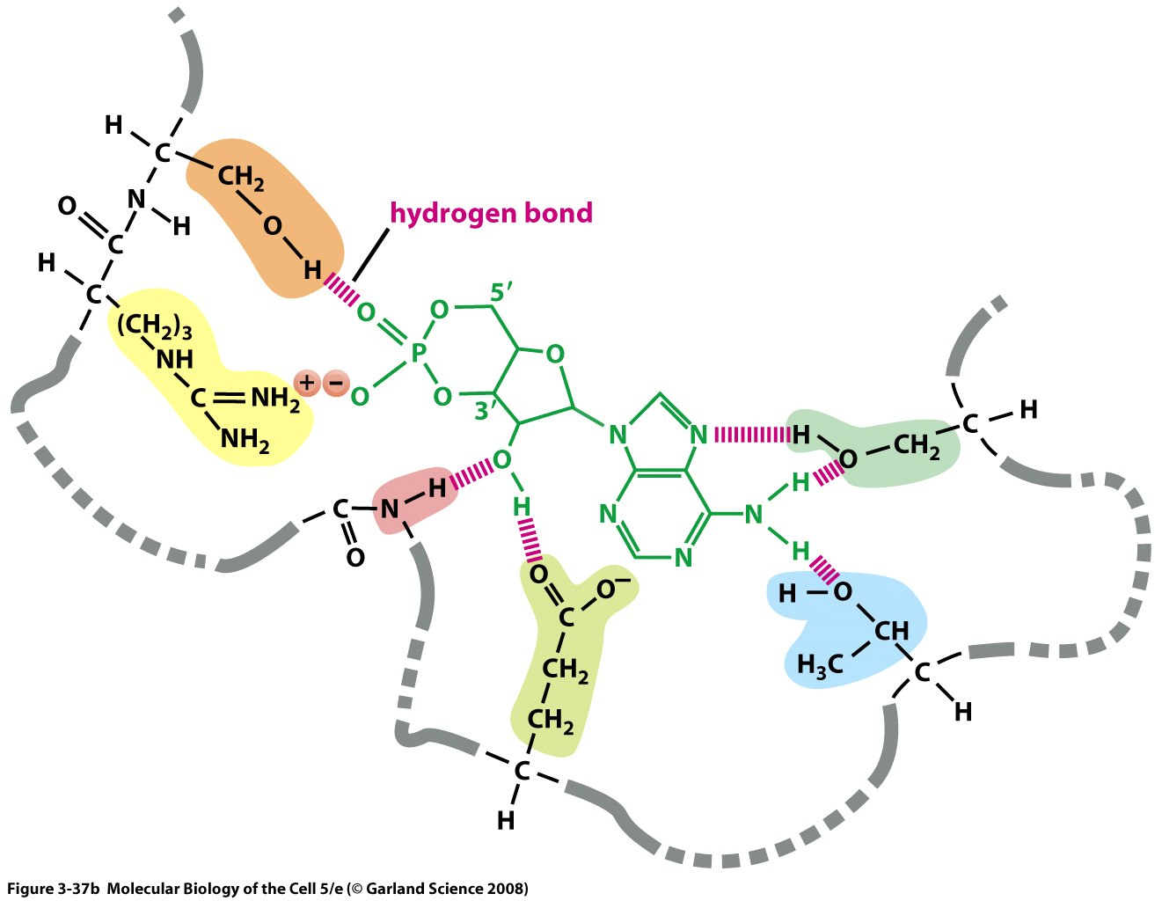
Protein structure determines interactions with other molecules

Slide 22
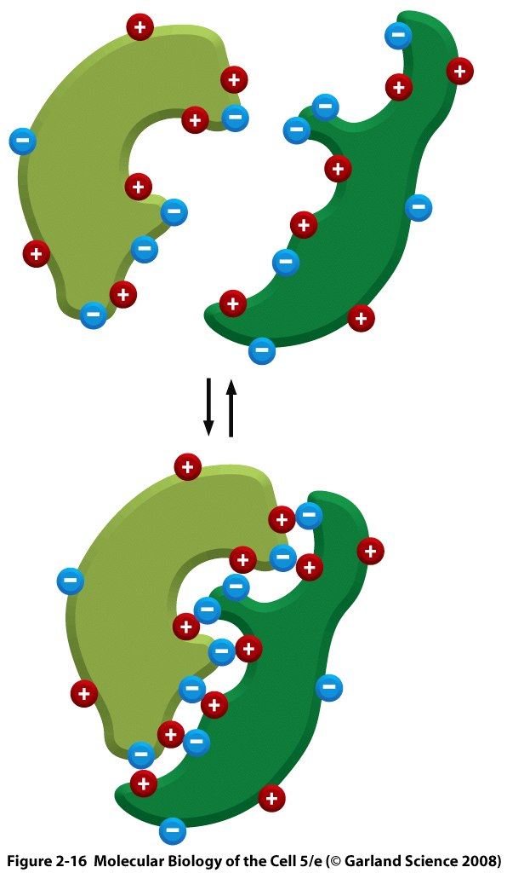
Protein structure affects protein-protein interactions
Notes:
How would changing the salt concentration affect this binding? How would changing the pH affect this binding?

Slide 23
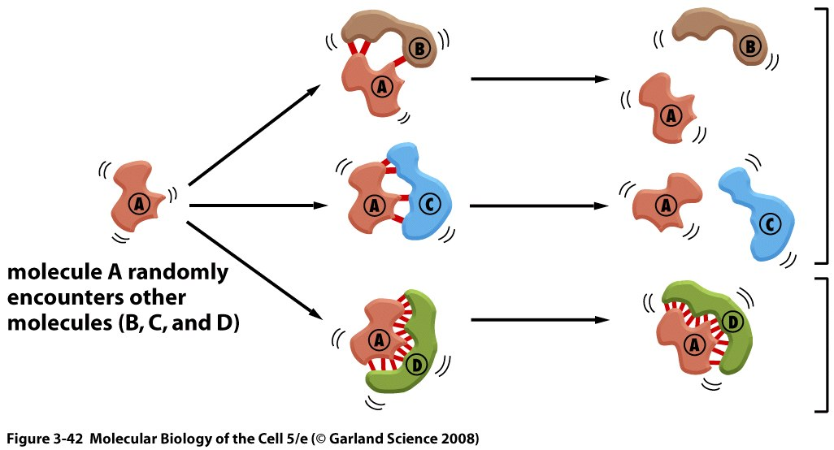
Protein structure affects protein-protein interactions

Slide 24
Disease variant’s effect on proteins
Stability
Protein itself
Abundance
Function
Through interactions
(including regulatory effects)

Slide 25
Part 2:
Disease variants of MLH1
(DNA mismatch repair)

Slide 26


Slide 27
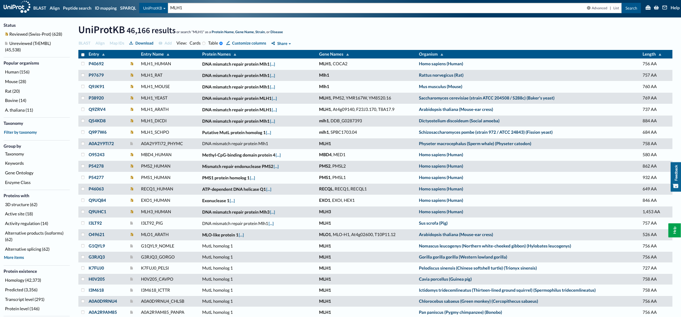
Uniprot database
https://www.uniprot.org

Slide 28
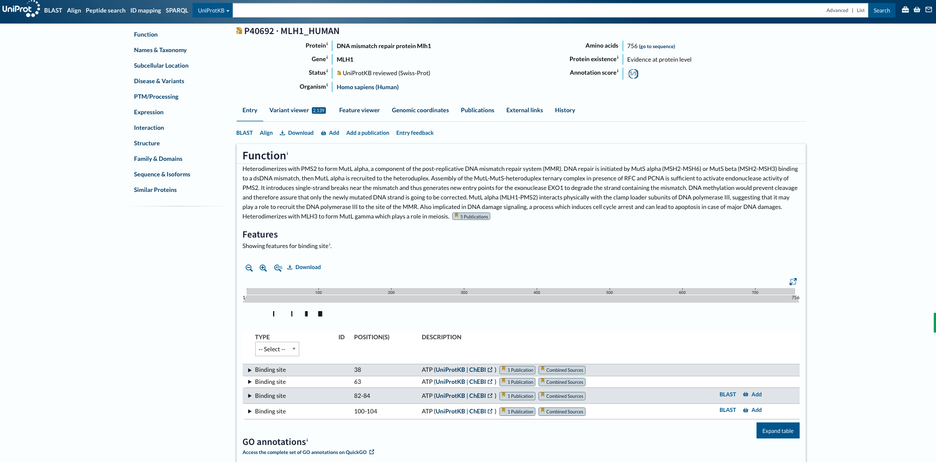
Uniprot database
Class activity
Group 1: Function
Group 2: Feature
Group 3: GO annotation
Group 4: Expression
Group 5: Interactions

Slide 29
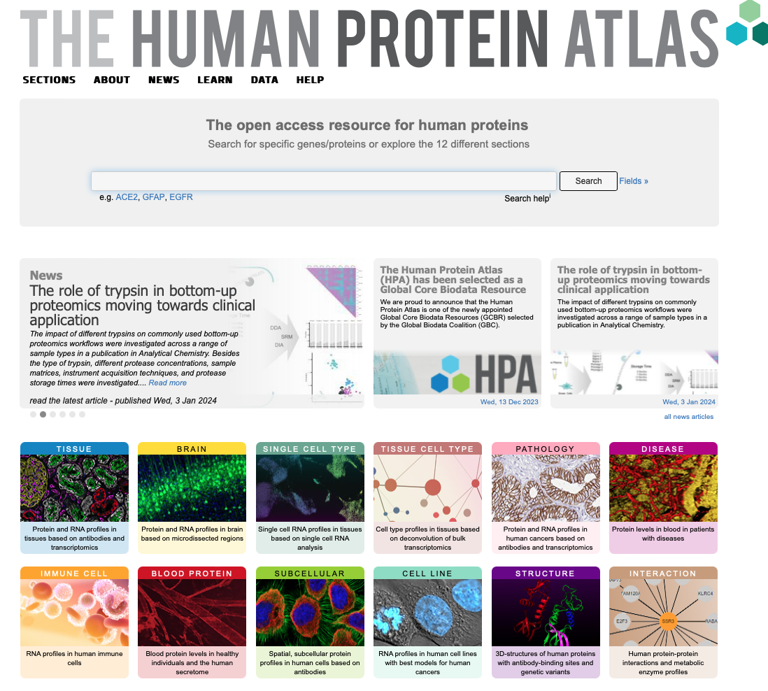
HPA database
https://www.proteinatlas.org

Slide 30
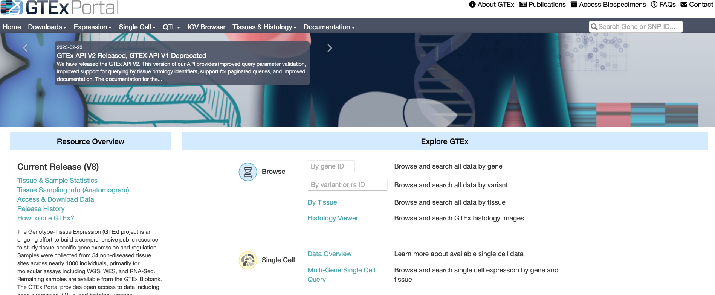
GTEx portal
https://www.gtexportal.org/home/

Slide 31
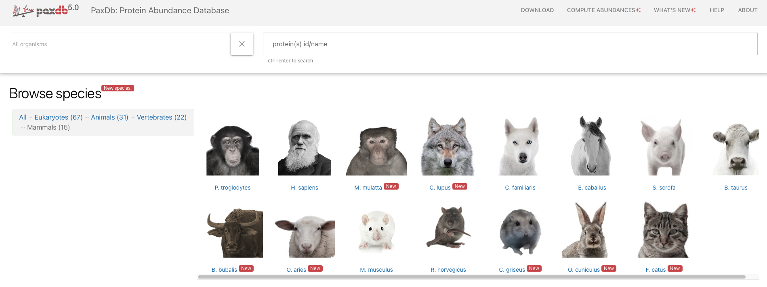
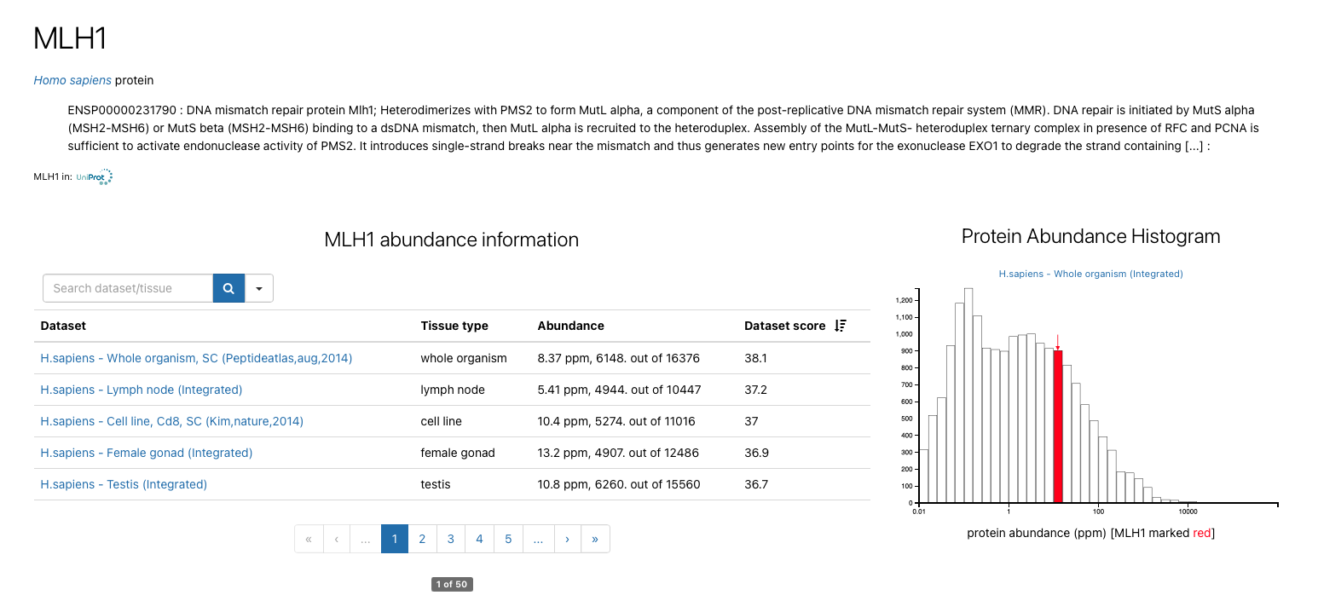
Paxdb database
https://pax-db.org

Slide 32
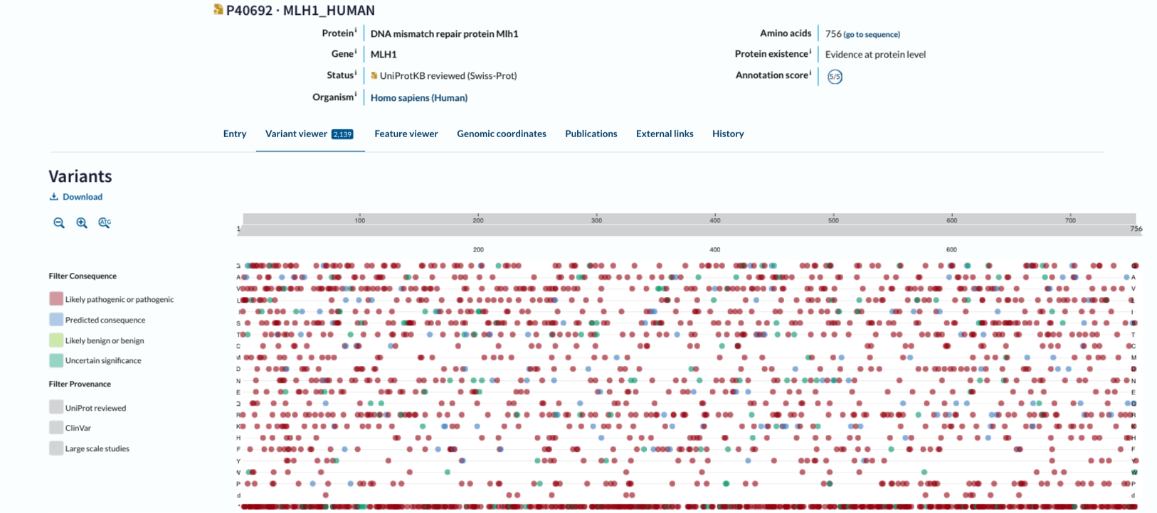
Uniprot database: variant page
Class activity
Group 1: 1-70
Group 2: 71-140
Group 3: 141-210
Group 4: 210-280
Group 5: > 280
Look at pathological/clinical variants that fall in these position bins

Slide 33
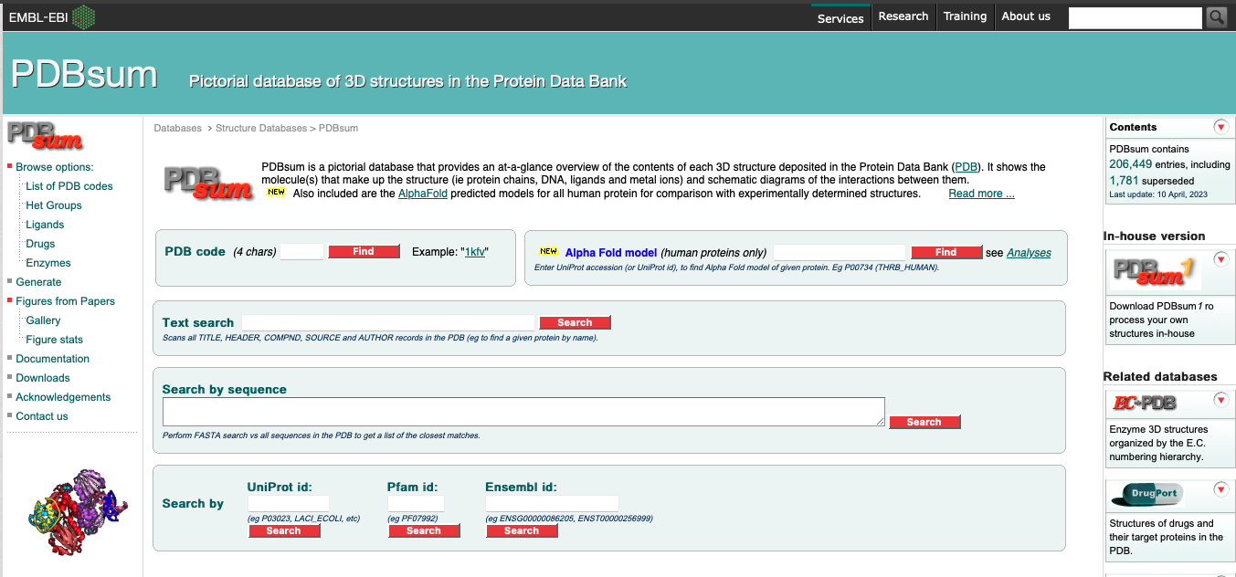
PDBsum database (EMBL-EBI)

Slide 34
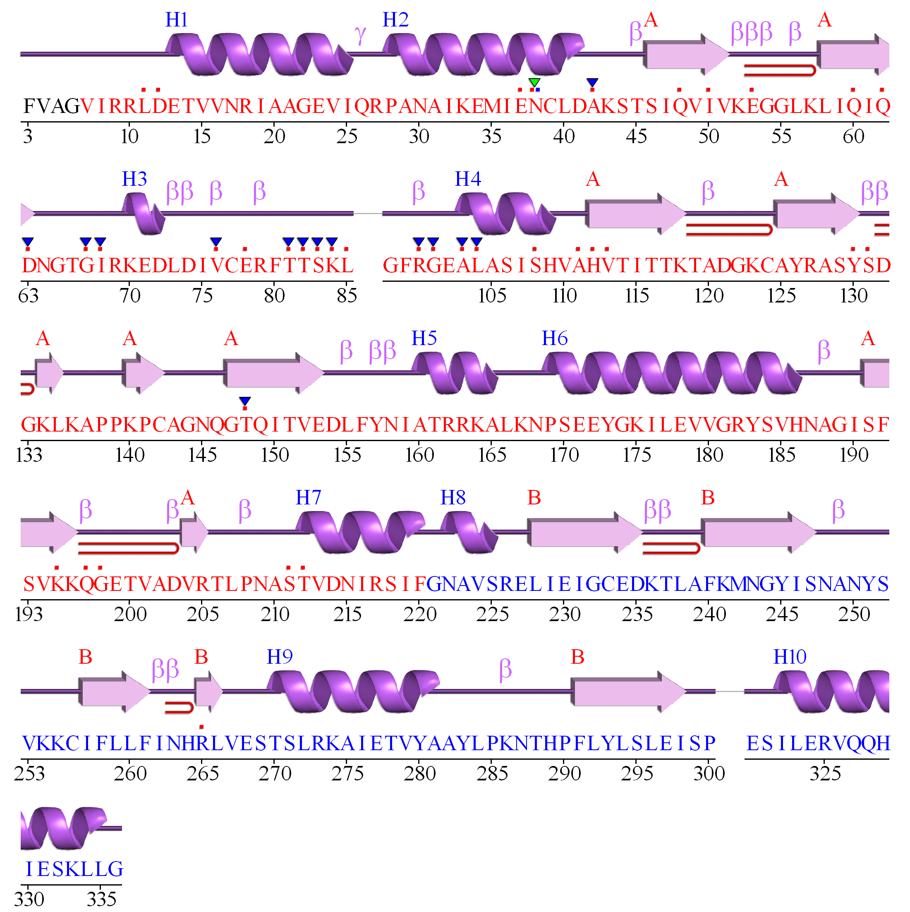
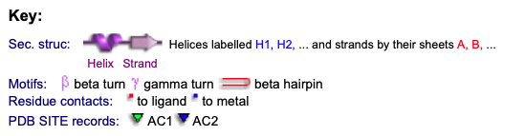

Slide 35
Did you notice any difference between the protein length (in structure) and the gene length?

Slide 36
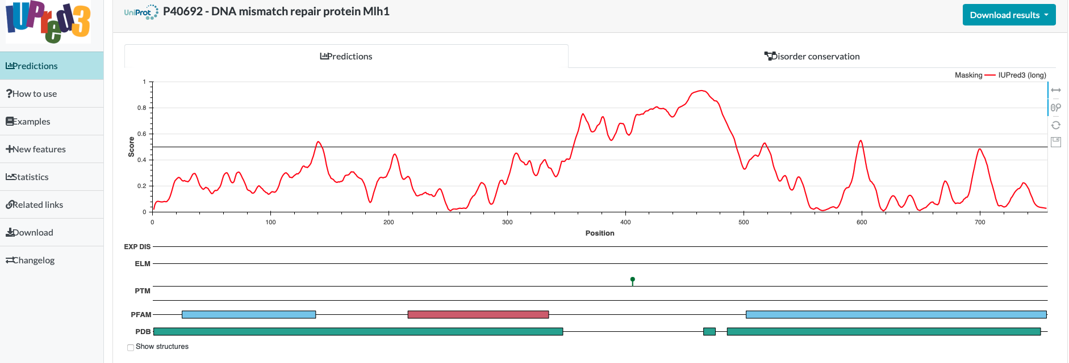
Iupred database

Slide 37
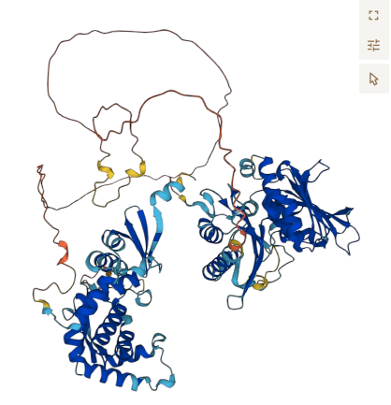
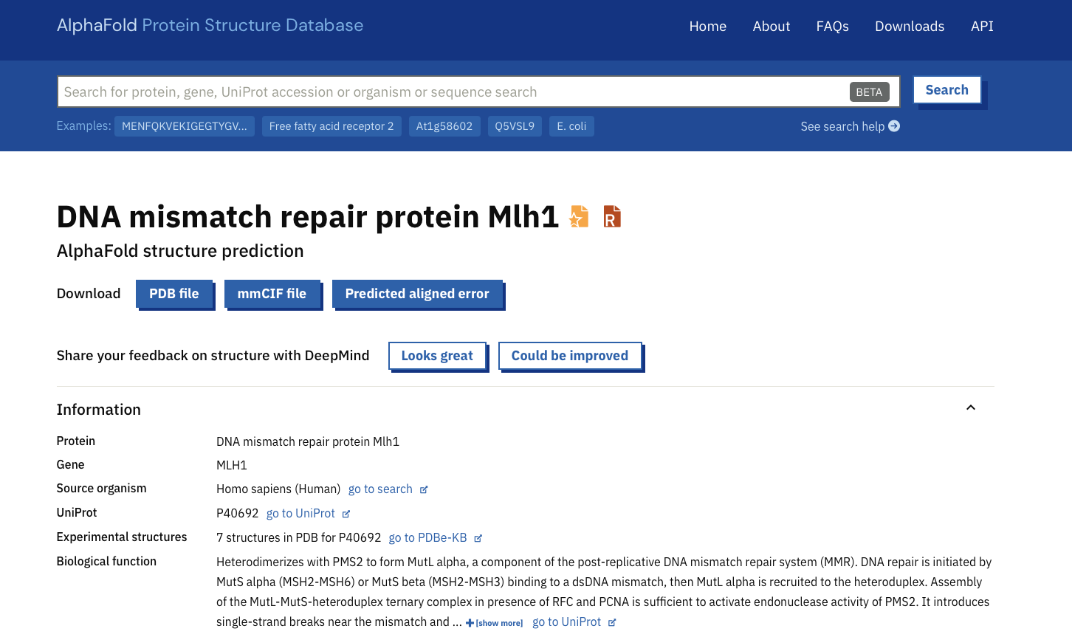
AlphaFold (EMBL)
https://alphafold.ebi.ac.uk

Slide 38


Slide 39
What clinical variants fall in the disordered regions?

Slide 40
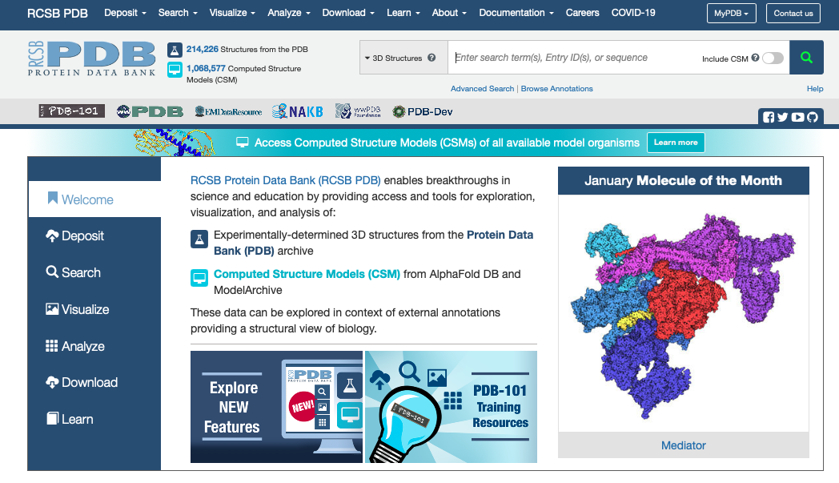

Slide 41
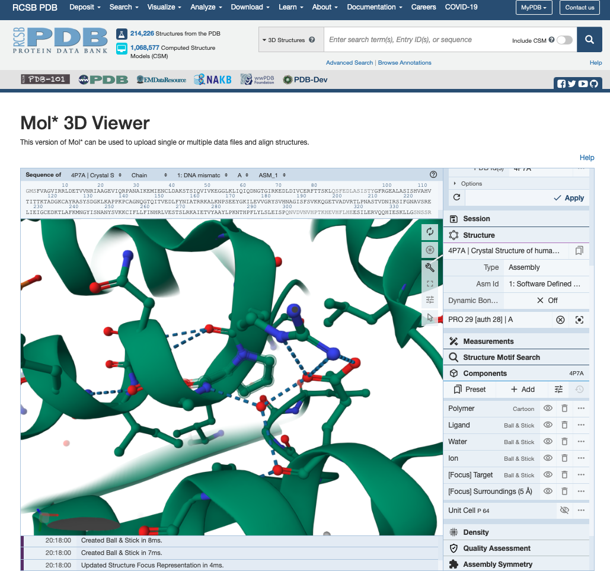
Disease variant:
P28L

Slide 42
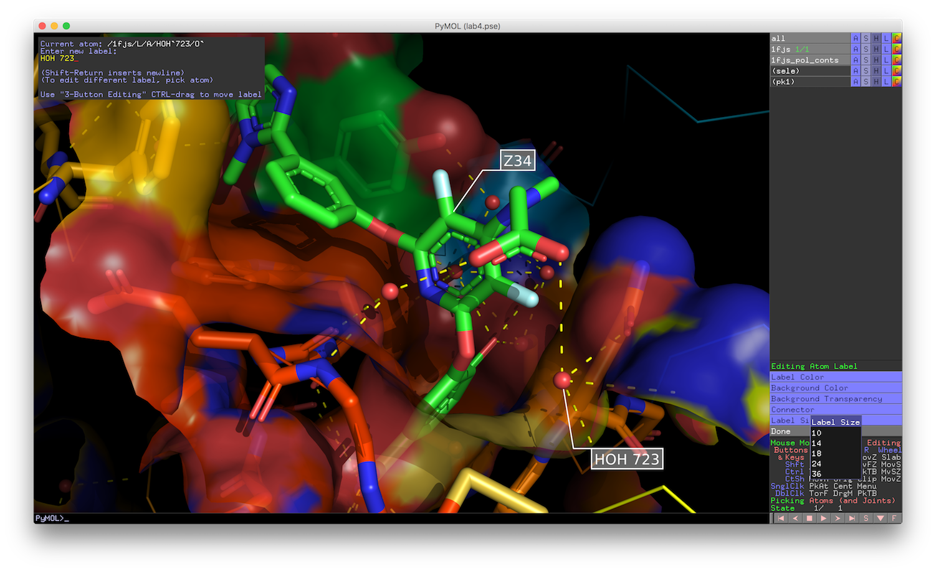
Pymol: Protein and Molecular Visualization

Slide 43
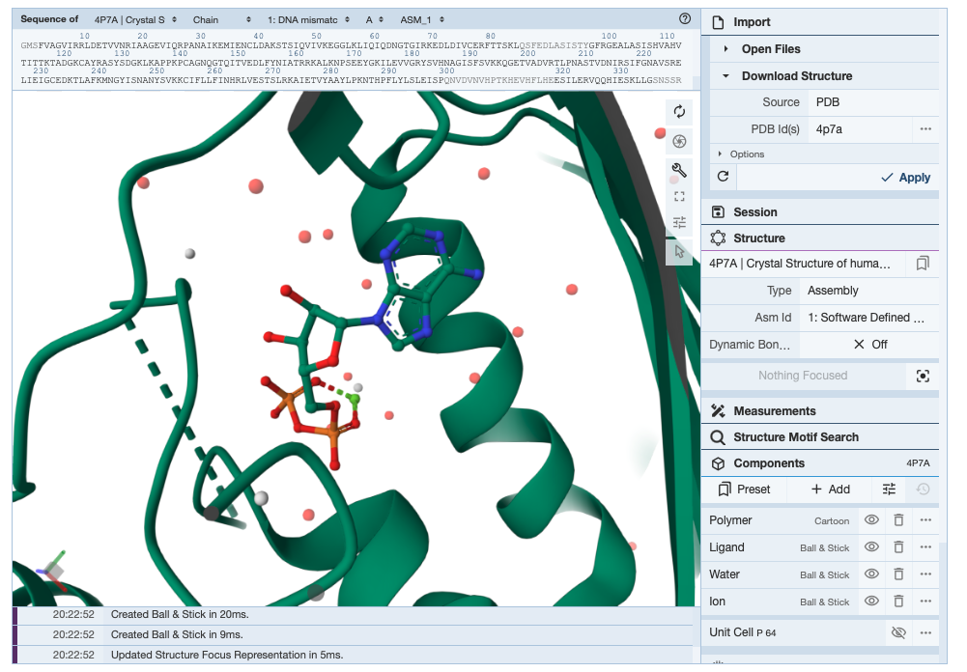
Which variants might affect the ATP binding affinity?
Cross validate your results with PDBsum (EMBL) database

